Slide 1
Intrusion Detection System
Vineet Rao
Vinayak Borhade
Ameya Daddikar
Rishabh Bansal

Slide 2
INTRUSION
Any activity or set of activities that compromises the confidentiality, availability and integrity of a system
Can include all the attacks, like DoS, masquerade, replay.
In context of IDS, a system is an autonomous set of resources, like computers, telephones, smart devices, etc. usually connected by a network to the outside world.

Slide 3
WHAT IS IDS?
Device or application used to monitor networks
Used to detect malicious activity on a network
Can also detect policy violations (eg. classified data leaving the network)
Usually sets off an alarm when detecting any activity considered an intrusion (including policy violation)
Further action can be taken by admin

Slide 4
IDS VS FIREWALL
IDS
Detection
Cannot block any activity or connection
Also considers intrusion within the network
FIREWALL
Protection
Can be used to block connections not matching rules
Does not interact with intra-network traffic

Slide 5
Types
On basis of detection:
Signature Based
Anomaly Based
On scope:
Network based
Host based
Perimeter
VM based

Slide 6
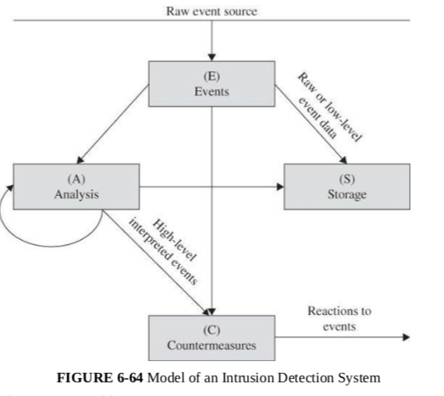

Slide 7
DETECTION
IDS history started with the US Air Force
The report “Computer Security Threat Monitoring and Surveillance,” is credited with introducing IDS
The first model worked like anti-virus apps
Known threats were stored in a list
Network traffic was scanned and compared with known attacks
Describes signature based method
Issues were updating knowledge base and detecting zero day exploits

Slide 8
NEWER MODELS
Anomaly based model considers the normal traffic and behaviour within a network and uses anomalies in traffic to detect a threat
Consists of two phases:
Training phase, used to create a profile of normal behaviour
Testing phase, used to compare current traffic with normal behaviour learned
Methods to detect anomalies:
ANNs
Strict anomaly detection
Data mining method
Artificial Immune system

Slide 9
SCOPE OF IDS
Network IDS monitors multiple hosts, on a hub, switch or tap
Analyses packet traffic
Host based IDS monitors a single host
Analyses system calls, application logs, file-system modifications
Is a software agent on a host
Perimeter IDS detects and pinpoints the location of intrusion attempts on perimeter fences of critical infrastructures
Virtual Machine IDS uses VM monitoring
Newest method

Slide 10
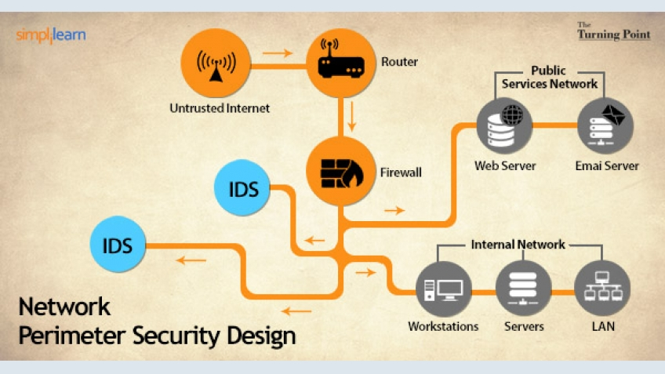

Slide 11
NIDS vs HIDS
Monitoring port, used to view all traffic through device
Signature matching
Large networks can be monitored
Ongoing network operations won’t be interrupted
Not susceptible to direct attack
Cannot analyze encrypted packets
Difficult to use fragmented packets
Monitoring system configuration databases
Principle of configuration and change management
Attacks local events detected
Encrypted traffic is decrypted on the host, and thus visible
Detect inconsistencies in the application
More management efforts required
Susceptible to someDoS related attacks and host attacks

Slide 12
OTHER TECHNOLOGY
Code modification checkers are programs that compare active code with saved digest of a code, to avoid malicious code changes
Vulnerability scanners can scan the system to detect vulnerabilities
Intrusion Prevention System (IPS) is software which in addition to detecting can also take actions to prevent an intrusion

Slide 13
RESPONSE
Possible Responses:
Monitor, collect data, increase amount of data collected
Protect, act to reduce exposure
Signal alert to other production components
Call a human

Slide 14
Adaptive Behavior
~When mere humans alone can’t act on the alarms

Slide 15
Case Study:
Target Corp. overwhelmed by too many alarms
Target: A major retailer in the United States
Russian Hackers infiltrated network of Target
Attackers collected shopper's credit/debit cards, verification numbers
40 million numbers stolen in few weeks before Christmas
Target’s security monitoring system (IDS) analyzed the situation and raised alarm to firm’s security operations center on 30 November and 2nd December
Experts say Target Security Team received hundreds of such alerts every day
Conclusion: Unless someone acts on the alarm, raising it has no value

Slide 16
Adaptive Behaviour
Continue to monitor the network
Block the attack by redirecting attack traffic to monitor host, discarding the traffic, or terminating the session
Reconfigure the network by A. Bringing other hosts online (increase capacity) B. adjust load balancers
Adjust performance to slow the attack, e.g.: dropping some of the incoming traffic
Deny access to particular network hosts or services
Shut down part of the network
Shut down the entire network

Slide 17
Counterattacks
~And how it can go out of hand quickly
[fun stuff ( ͡° ͜ʖ ͡°) ]

Slide 18
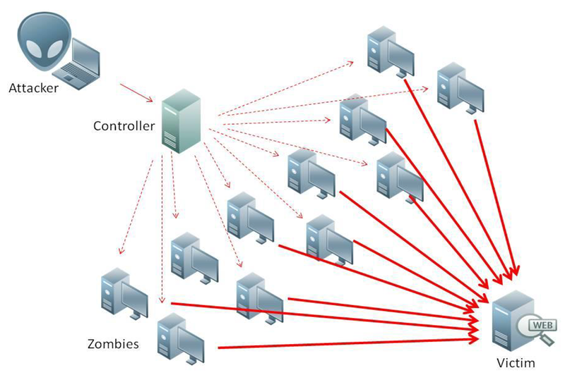
Things to consider before counter attacking
Determine the true source of the attack. Many times the apparent attacker might not be the true attacker (zombie computers). Attacking the wrong party will only make things worse

Slide 19
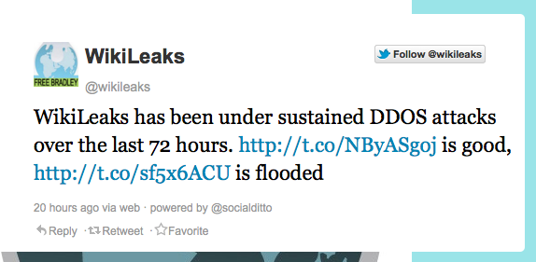

Things to consider before counter attacking
2. Can cause a real-time battle
(no seriously, this happened xD)
3. Retaliation in anger is not
necessarily well thought out
4. Provoking an attacker can lead to
escalation

Slide 20

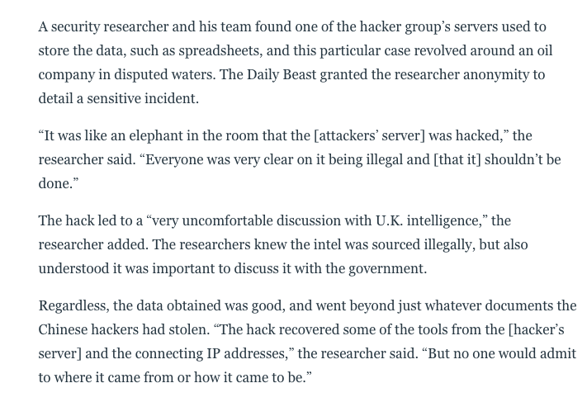
Things to consider before counter attacking
5. Taking offensive action opens
One to legal jeopardy, comparable
To the attacker
Notes:
Pena from Narcos narrowly escaped legal jeopardy

Slide 21

Limitations
~Nothing is absolutely perfect

Slide 22

Limitations
Noise
False Positives
Lag Time
Someone has to monitor
They Do Not Process Encrypted Packets
Signature Library Needs to Be Continually Updated
Notes:
An administrator is foolish to buy and install an IDS and then ignore it.
Noise can severely limit an intrusion detection system's effectiveness. Bad packets generated from software bugs, corrupt DNS data, and local packets that escaped can create a significantly high false-alarm rate.
It is not uncommon for the number of real attacks to be far below the number of false-alarms. Number of real attacks is often so far below the number of false-alarms that the real attacks are often missed and ignored.
For signature-based IDS, there will be lag between a new threat discovery and its signature being applied to the IDS. During this lag time, the IDS will be unable to identify the threat.

Slide 23
Evasion Techniques
HTTP
Multiple Data Encodings - hex | base64 | xml
HTTPS
cannot be read by IDS - private key
Payload obfuscation
Encoding & Encryption
Notes:
An IDS can be evaded by obfuscating or encoding the attack payload in a way that the target computer will reverse but the IDS will not. In this way, an attacker can exploit the end host without alerting the IDS.

Slide 24
Evasion Techniques
NOP (Non-operational) slides
Unique Attack Patterns
Buffer Overflow
Polymorphic Shellcode
Decoder in the payload tricks the IDS and host
Payload obfuscation
Polymorphism

Slide 25
Evasion Techniques
Fragmentation
Split the packet
Pausing between fragments of packets
Difficult to re-assemble by IDS
Wait for IDS time out
Insertion and evasion
Fragmentation
Notes:
By itself, small packets will not evade any IDS that reassembles packet streams. However, small packets can be further modified in order to complicate reassembly and detection. One evasion technique is to pause between sending parts of the attack, hoping that the IDS will time out before the target computer does. A second evasion technique is to send the packets out of order, confusing simple packet re-assemblers but not the target computer.

Slide 26
Stealth Mode
Notes:
A network IDS is better able to protect itself against detection or compromise than a host-based one because the network IDS can operate in so-called stealth mode, observing but never sending data onto the network. Its network interface card can even be restricted to receive data only, never doing anything to reveal its connection to the network.

Slide 27
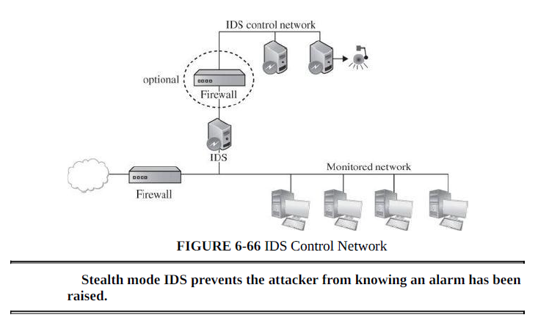
Internal IDS - Architecture
Notes:
To counter those problems, most IDSs run in stealth mode, whereby an IDS has two network interfaces: one for the network (or network segment) it is monitoring and the other to generate alerts and perhaps perform other administrative needs. The IDS uses the monitored interface as input only; it never sends packets out through that interface. Often, the interface is configured so that the device has no published address through the monitored interface; that is, no router can route anything directly to that address because the router does not know such a device exists. It is the perfect passive wiretap. If the IDS needs to generate an alert, it uses only the alarm interface on a completely separate control network.

Slide 28

IDS Example: SNORT

Slide 29
About SNORT
(Open source NIPS) network intrusion prevention system
Maintained by CISCO Systems
Capable of performing real-time traffic analysis and packet logging on IP networks.
It can perform protocol analysis, content searching/matching, and can be used to detect a variety of attacks and probes, such as buffer overflows, stealth port scans, CGI attacks, SMB probes, OS fingerprinting attempts, and much more.
Three Primary Uses: I. A straight packet sniffer like tcpdump Ii. A packet logger (useful for network traffic debugging, etc)
Iii. A full blown NIPS.

Slide 30
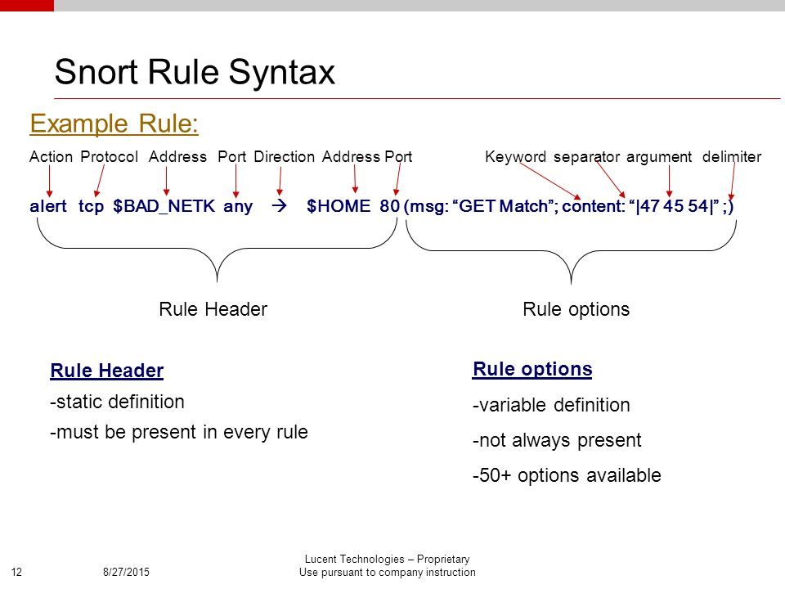

Slide 31

IDS Example:
OSSEC

Slide 32
OSSEC IDS
Open Source Server Intrusion Detection for Every Platform
scalable, multi-platform, open source Host-based Intrusion Detection System (HIDS)
Supported Platforms: Linux, Solaris, AIX, HP-UX, BSD, Windows, Mac and VMware ESX.
powerful correlation and analysis engine, integrating log analysis, file integrity monitoring, Windows registry monitoring, centralized policy enforcement, rootkit detection, real-time alerting and active response

Slide 33
OSSEC Features
Log based Intrusion Detection (LIDs) Actively monitors and analyzes data from multiple log data points in real-time
Rootkit and Malware Detection Process and file level analysis to detect malicious applications and rootkits
Active Response
Respond to attacks and changes on the system in real time through multiple mechanisms including firewall policies, integration with 3rd parties such as CDN’s and support portals, as well as self-healing actions

Slide 34
OSSEC Features
Compliance Auditing Application and system level auditing for compliance with many common standards such as PCI-DSS, and CIS benchmarks
File Integrity Monitoring (FIM) For both files and windows registry settings in real time not only detects changes to the system, it also maintains a forensic copy of the data as it changes over time.
System Inventory
Collects system information, such as installed software, hardware, utilization, network services, listeners and other information.

Slide 35
References
Security in Computing - Pfleeger
Network Based Intrusion Detection and Prevention Systems: Attack Classification , Methodologies and Tools
https://snort.org/
https://www.ossec.net
https://en.wikipedia.org/wiki/Intrusion_detection_system#Limitations
https://en.wikipedia.org/wiki/Intrusion_detection_system_evasion_techniques

